Slide 1


Organizational Behavior
(OB)
Prof. Dr. Mukhtar Ahmed

Slide 2
Organizational Behavior
(MGT-502)
Lecture-1

Slide 3
Organizational Behavior

Slide 4
The study of individual behavior and group dynamics in organizational settings

Slide 5
Organizational Behavior
. . . a field of study that investigates the impact that individuals, groups and structure have on behavior within organizations, for the purpose of applying such knowledge toward improving an organization’s effectiveness.
Notes:
This material is found in more detail on pages 7-9.

Slide 6
Forces reshaping the process of management

Slide 7


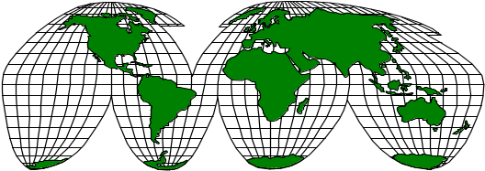
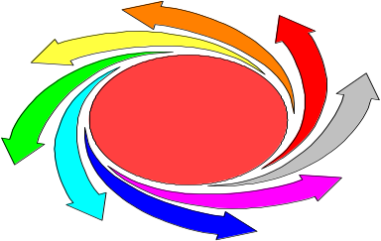
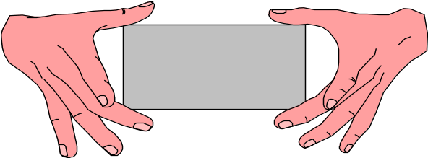
Power of Human Resources
Cultural Diversity
Globalization
Employer-
Employee
Rapid Change
New Psychological Contract

Slide 8
Organizational Behavior
The study of individual behavior and group
dynamics in organizational settings
Organizational Variables
Performance appraisal Work design
Communications
Human Behavior
Organizational Design
Organizational Structure Jobs
Notes:
2

Slide 9
The Study of OB

Slide 10
Behavior is a function of both the Person and the Environment.
B = f (P/E)

Slide 11
Psychology
Individual
Sociology
Study of
Organizational
Behavior
Social Psychology
Group
Anthropology
Organization
Political Science

Slide 12
Contributing Disciplines to the OB Field

Slide 13
Psychology
  The science that seeks to measure, explain, and sometime change the behavior of humans and other animals.

Slide 14
Learning
Motivation
Personality
Emotions
Perception
Training
Leadership effectiveness
Job satisfaction
Individual decision making
Performance appraisal
Attitude measurement
Employee selection
Work design
Work stress
Psychology
Individuals

Slide 15
Sociology
  The study of people in relation to their fellow human beings.

Slide 16
Group dynamics
Work teams
Communication
Power
Conflict
Inter-group behavior
Organization
system
Sociology
Formal organization theory
Organizational technology
Organization change
Organizational culture
Group

Slide 17
Social psychology
  An area within psychology that blends concepts from psychology and sociology and that focuses on the influence of people on one another.

Slide 18
Behavioral change
Attitude change
Communication
Group processes
Group decision making
Social psychology
Group

Slide 19
Anthropology
  The study of societies to learn about human beings and their activities.

Slide 20
Comparative values
Comparative attitudes
Cross-cultural analysis
Group
Anthropology
Organizational culture
Organizational environment
Organization
system

Slide 21
Political science
  The study of the behavior of individuals and groups within a political environment.

Slide 22
Conflict
Intra-organizational politics
Power
Organization
system
Political Science

Slide 23
Psychology
Individual
Sociology
Study of
Organizational
Behavior
Social Psychology
Group
Anthropology
Organization
Political Science

Slide 24
Why Do We Study OB?

Slide 25
To learn about yourself and how to deal with others
You are part of an organization now, and will continue to be a part of various organizations
Organizations are increasingly expecting individuals to be able to work in teams, at least some of the time
Some of you may want to be managers or entrepreneurs

Slide 26
Understand
organizational
events
Organizational
Behavior
Research
Influence
organizational
events
Predict
organizational
events

Slide 27
The importance of studying organizational behavior (OB)

Slide 28
OB is a way of thinking.
OB is multidisciplinary.
There is a distinctly humanistic orientation with OB.
The field of OB is performance oriented.
The external environment is seen as having significant impact on OB.

Slide 29
A Manager’s Preview
Describe . . . Diagnose . . . Prescribe . . . Act

Slide 30
HANDLE the challenges faced by today’s organizations.
DEAL with today’s workforce.
DEMONSTRATE the competencies needed by effective managers.
UNDERSTAND the importance of effective organizational behavior.
Systematically DESCRIBE and STUDY organizational behavior.
APPLY the four-step diagnostic approach.
Notes:
4

Slide 31
The Four-Step diagnostic approach

Slide 32
DESCRIPTION
Data Collection through Observation,
Questionnaires, Interviews
DIAGNOSIS
Identification of Key Factors;
Applications of Theories and Concepts
PRESCRIPTION
Identification of Solutions to Problems
or Ways of Changing Situations
ACTION
Implementation of Solutions;
Evaluation of Solutions
Notes:
13

Slide 33
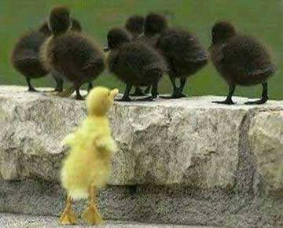
OB
Systematic study of how people behave in organizations

Slide 34

Enough for today. . .

Slide 35
Summary

Slide 36
Organizational Behavior
. . . a field of study that investigates the impact that individuals, groups and structure have on behavior within organizations, for the purpose of applying such knowledge toward improving an organization’s effectiveness.
Notes:
This material is found in more detail on pages 7-9.

Slide 37
Understand
organizational
events
Organizational
Behavior
Research
Influence
organizational
events
Predict
organizational
events

Slide 38
Organizational Behavior
(MGT-502)
Lecture-1

